Slide 1

Vel Tech Rangarajan Dr. Sagunthala R&D Institute of Science and Technology
School of Computing
Department of Computer Science and Engineering
10211CS224 / FULL STACK APPLICATION DEVELOPMENT (JAVA)
PROJECT REVIEW : MILESTONE PROJECT – 1
Date: 25-03-2026
RELATIONAL INVENTORY CONTROL & STOCK TRACKING SYSTEM
SDG: SDG 9 – Industry, Innovation and Infrastructure
Presented By:
K.Sumanth Reddy – VTU26845– 23UECS0253.
Courses Handling Faculty:
Dr. HAFIZUR RAHMAN - B.E., M.Tech., Ph.D. ASSISTANT PROFESSOR

Slide 2
INTRODUCTION
1
Traditional inventory systems using manual records and spreadsheets often cause data errors and stock mismanagement.
Lack of a centralized relational database makes tracking stock movement and maintaining data integrity difficult.
This project automates inventory control to reduce human errors and improve operational efficiency.
A relational database structure ensures organized data storage with proper relationships between entities.
The system is highly relevant in retail, manufacturing, healthcare, and warehouse industries.
It helps businesses avoid overstocking and stock shortages through accurate stock monitoring.
The system manages products, suppliers, and transactions using structured relational tables.
It provides real-time stock updates and generates reports for better inventory analysis and decision-making.
2
3
4
5
6
7
8
9

Slide 3
PROBLEM STATEMENT
1
Many organizations still use manual or spreadsheet-based methods to manage inventory, which often leads to errors and inefficiencies.
These systems do not provide real-time updates of stock levels.
Tracking stock movement across suppliers, stores, and departments becomes difficult.
Data redundancy and inconsistency occur due to the absence of a relational database.
Incorrect stock information may result in overstocking or stock shortages.
Generating accurate inventory reports is time-consuming and unreliable.
There is no centralized system to monitor stock-in and stock-out transactions.
Hence, there is a need for an automated relational inventory control and stock tracking system.
2
3
4
5
6
7
8
9

Slide 4
OBJECTIVE(S)
1
2
3
To design and develop a relational inventory control system that accurately records and manages stock-in and stock-out transactions.
To improve inventory monitoring by providing real-time stock updates and generating accurate inventory reports.
4
5
6
7
8
9

Slide 5
PROPOSED SYSTEM
The system uses a centralized relational database to store products, suppliers, and transaction details in structured tables.
It automates stock-in and stock-out processes to ensure real-time inventory updates.
The system maintains proper relationships between entities to avoid data redundancy and inconsistency.
It provides instant access to current stock levels, reducing delays in inventory tracking.
The system reduces human errors through validation and controlled data entry.
It supports better decision-making by providing reliable and up-to-date inventory information.
Compared to traditional systems, it offers improved efficiency, scalability, and data security.
Automated report generation improves accuracy and saves time compared to manual methods.
1
2
3
4
5
6
7
8
9

Slide 6
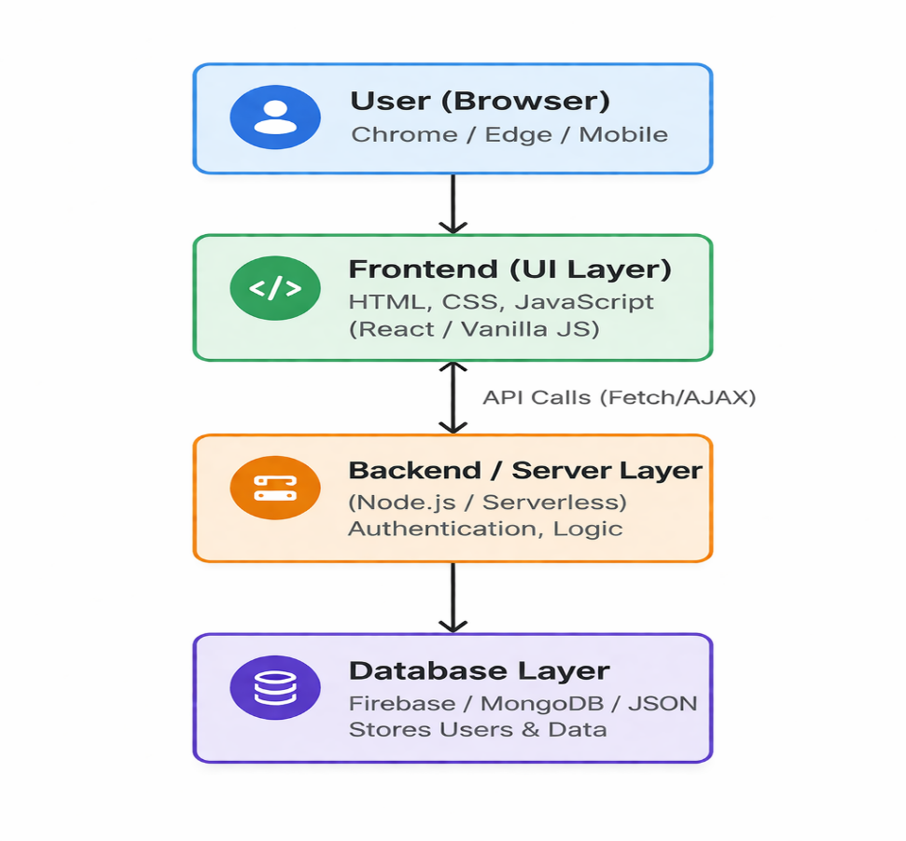
PROPOSED SYSTEM ARCHITECTURE
1
2
3
4
5
Input: Data is collected from various sources, such as suppliers providing delivery notes or customers placing sales orders.
Processing: Data is analyzed and processed through logic like stock-in validation, decrementing quantities during sales, and calculating reorder points.
Database: Data is stored and managed within normalized relational tables (e.g., Products, Inventory, and Suppliers) to ensure transactional integrity and consistency.
Output: Information is delivered to users in the form of low-stock alerts, warehouse pick-lists, and real-time financial valuation reports.
6
7
8
9

Slide 7
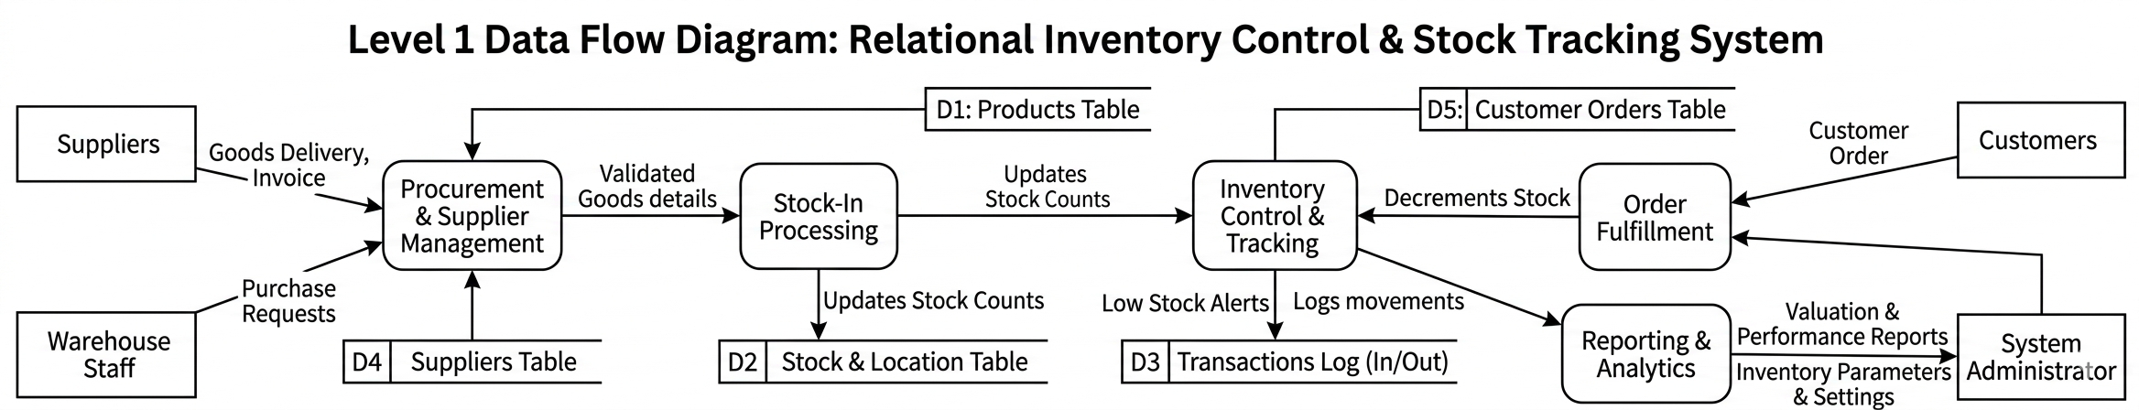
WORKFLOW
1
2
3
4
5
6
7
Relational Data Integrity: The system utilizes normalized database tables to link unique IDs for products, suppliers, and orders, ensuring any single update reflects instantly across all modules.
Automated Stock Monitoring: By tracking real-time quantities against pre-defined reorder points, the system automatically triggers replenishment alerts to prevent stockouts and minimize excess inventory.
Real-Time Financial Reporting: Every stock movement is logged as a discrete transaction, allowing the system to provide immediate valuation reports and profit margin analysis using methods like FIFO or Average Cost.
8
9

Slide 8
TECHNOLOGIES USED
Frontend:
HTML5 – Structure of web pages
CSS3 – Styling and layout
JavaScript – Client-side validation & interactivity
Bootstrap – Responsive UI design
Backend:
Java (JSP & Servlets) – Business logic and request handling
PHP – Server-side scripting
Python (Django / Flask) – Backend framework
Database:
Firebase – Relational database for inventory, stock, and transactions
Tools:
Visual Studio Code / Eclipse – Code editor & IDE
Git & GitHub – Version control
1
2
3
4
5
6
7
8
9

Slide 9
MODULE DESCRIPTION
Module 1: User & Role Management
Handles user authentication, login, and role-based access (Admin, Store Manager). Ensures secure access to inventory operations and system features.
Module 2: Product & Inventory Management
Manages product details such as product ID, name, category, price, and stock levels. Supports adding, updating, and removing products while maintaining accurate inventory records.
Module 3: Stock Inward & Outward Processing
Records incoming stock from suppliers and outgoing stock due to sales or usage. Automatically updates stock quantities and maintains transaction history.
Module 4: Supplier & Database Management
Maintains supplier details and manages relational database operations including storage, retrieval, updates, and data integrity across product, stock, and transaction tables.
Module 5: Reporting & Stock Analytics
Generates stock reports, low-stock alerts, and inventory summaries to support efficient decision-making and prevent over-stocking or stock shortages.
1
2
3
4
5
6
7
8
9

Slide 10
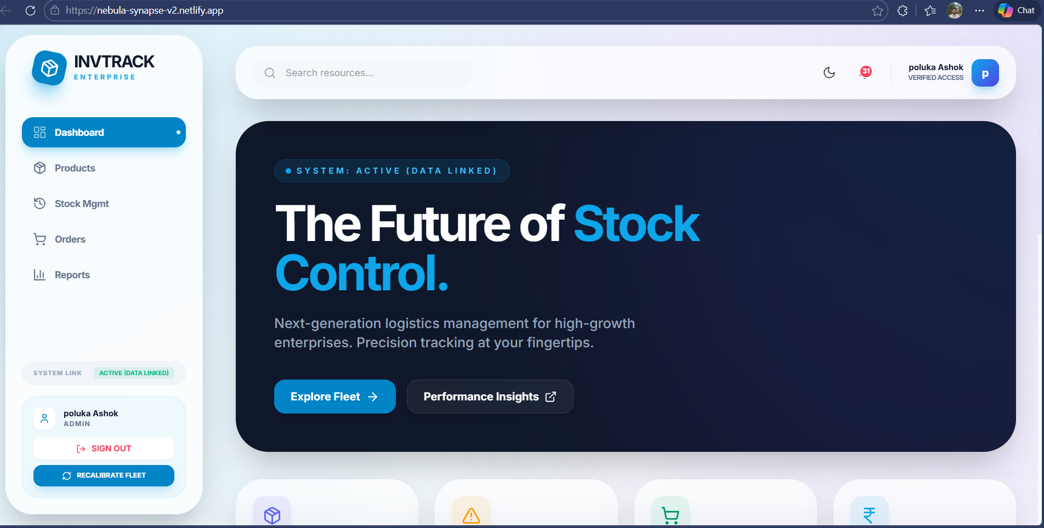
IMPLEMENTATION SCREENSHOTS
1
This is the Dashboard page of StockProInventory System, showing key business metrics like Total Products, Inventory Value, Sales Today, and Stock Alerts for quick monitoring.
It also includes navigation modules (Products, Suppliers, Purchases, Sales, Reports) and visual analytics sections like Sales Trend and Stock by Category for real-time stock analysis.
2
3
4
5
6
7
8
9

Slide 11
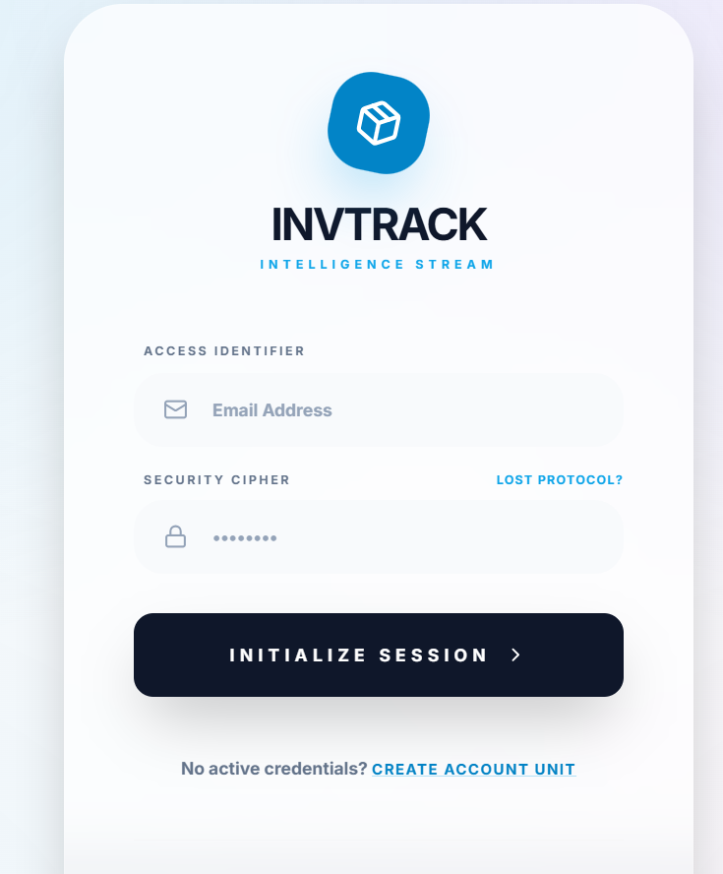
IMPLEMENTATION SCREENSHOTS
• This is the Create Account (Sign Up) page where new users register using their email address and password to access the inventory system.
• It enables secure user authentication and provides a link to the Sign In page for existing users.
1
2
3
4
5
6
7
8(A)
9

Slide 12
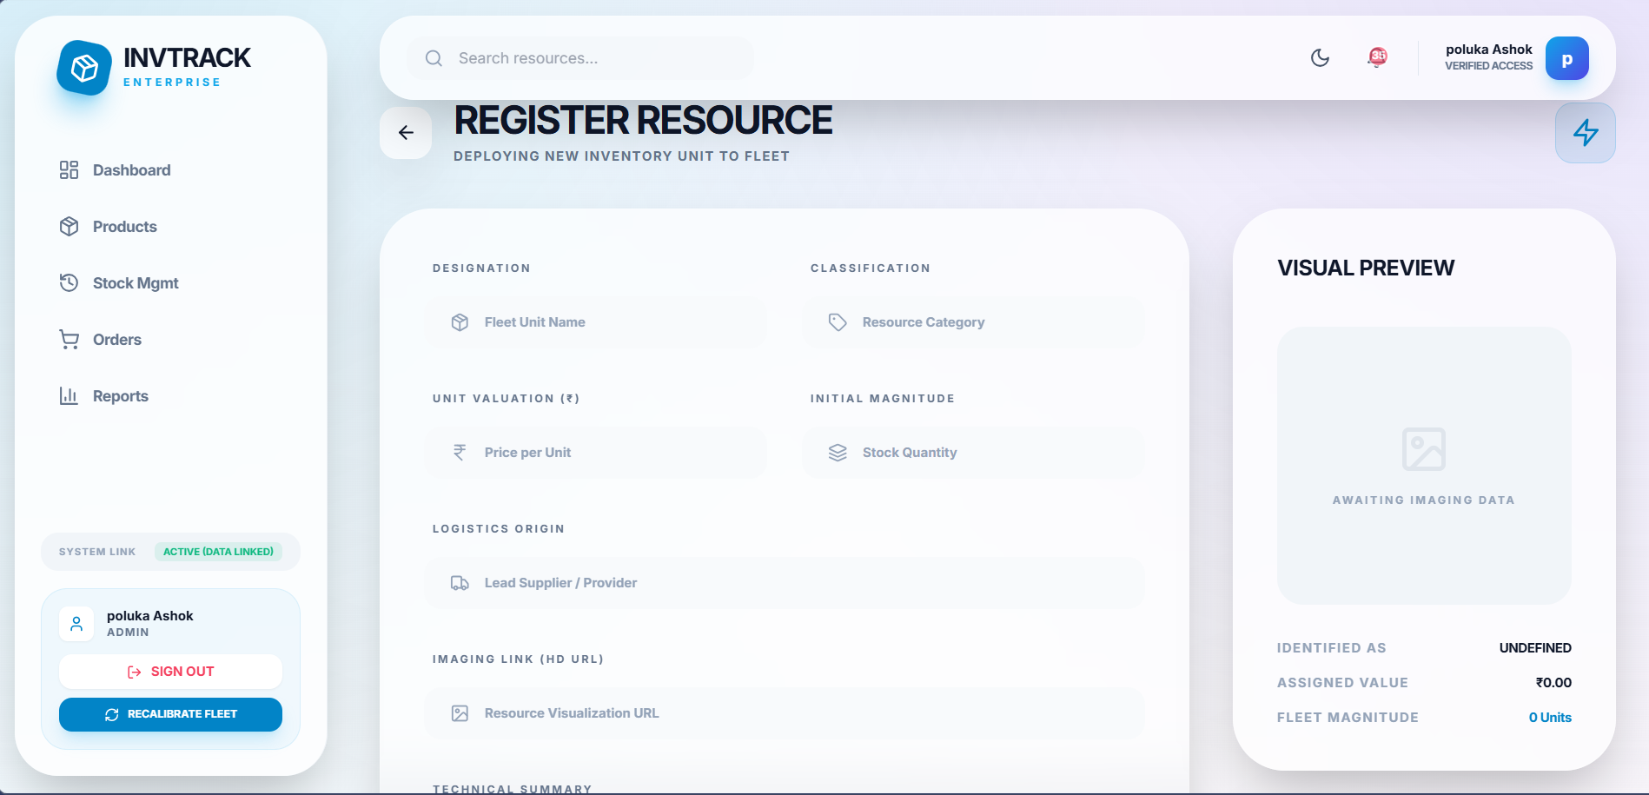
IMPLEMENTATION SCREENSHOTS
• This is the Add New Product page, where users enter product details like name, price, initial quantity, category, and supplier.
• It allows saving the product into the system database, which updates inventory stock and links it relationally with category and supplier.
1
2
3
4
5
6
7
8(B)
9

Slide 13
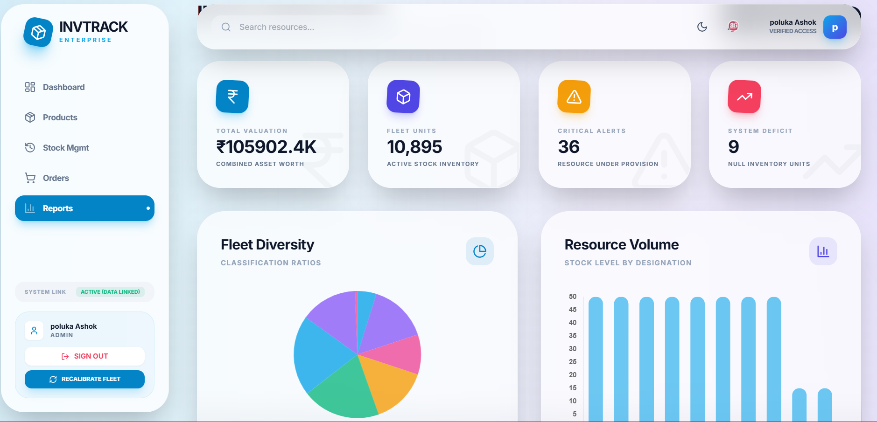
IMPLEMENTATION SCREENSHOTS
• This is the Reports page, which provides detailed inventory analysis including top-selling products and overall stock valuation.
• It helps managers monitor sales performance and inventory value, with an option to export report data as a CSV file for further analysis.
1
2
3
4
5
6
7
8(C)
9

Slide 14
ADVANTAGES & LIMITATIONS
1
Advantages
• Ensures data accuracy using relational database (Primary & Foreign Keys). • Provides real-time stock updates after purchase and sales transactions. • Reduces manual errors and improves operational efficiency. • Centralized data management for products, suppliers, and sales. • Generates reports for better decision-making and stock analysis. • Secure login system restricts unauthorized access. • Scalable structure for future feature expansion.
Limitations
• System depends on database/server availability. • Limited advanced analytics (no AI-based forecasting). • Requires manual data entry for transactions. • Performance may reduce with very large datasets (without optimization). • Limited role-based access control (if not implemented).
2
3
4
5
6
7
8
9

Slide 15
Thank you

